Slide 1
Project Name: Photography Portfolio
Name: Utsav Jitendrabhai Patel

Slide 2
Project Description:
This project is a portfolio website. In that, I am going to provide the company’s personal information about their work. This website is for business purposes.
List of Features:
1. Contact Form
2. Sidebar
3. Slide Show
4. Tags
5. Zoom-in
6. Read more

Slide 3
Targeted Audience:
Because of this portfolio people will know about my photography. And they can register and contact me. Basically, a photography portfolio’s main markets are weddings, anniversaries, celebrations, random pics of people, and events of surroundings.
Technical Consideration:
For this website, I am going to use HTML, CSS, and JavaScript. Explanation of 6 Features:
1: Contact form
2: Slide show
3: Sidebar
4: Read More >>(button) to redirect to post detail point of view
5: Zoom in the portfolio image
6: Tags
Responsibility and Roles:
On this website, my responsibility is the admin part. I will handle this site and reach out to people who contacted me. In the user part clients can observe the pics and register if they like to contact me.

Slide 4
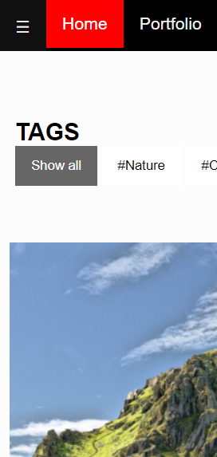
Project Feature 1: Sidebar

Slide 5


Slide 6
Description:
Sidebar is one of the basic features in my portfolio. If I click on the ☰ button it will open the sidebar on the left side. And it will display the navbar in that. And if I click the X button it will close the sidebar.
I created this feature so that there would be more space for the pictures on the website as it is a website people will visit to look at our pictures, I wanted to give the most space for that.

Slide 7
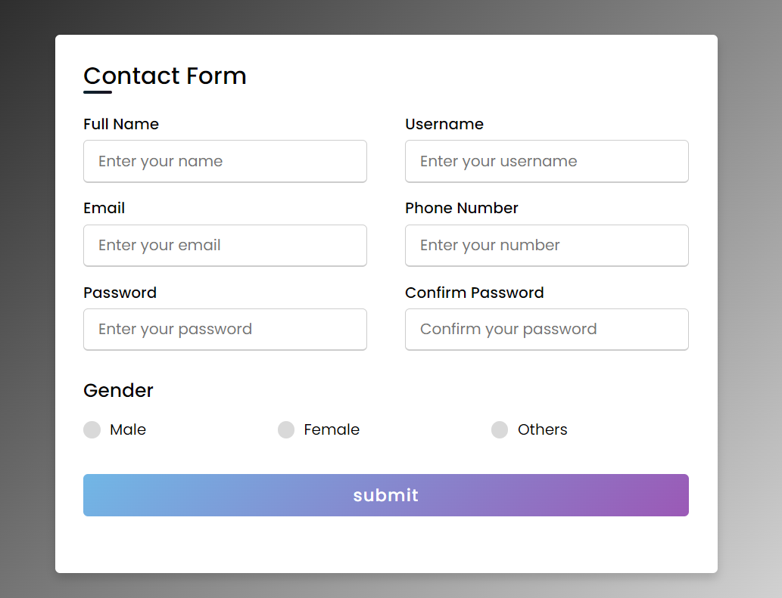
Project Feature 2: Contact Feature

Slide 8
Description:
Contact form is essential for every website. I decided to fetch information from the clients. Clients can give their details to me so I can contact them and have a business.

Slide 9
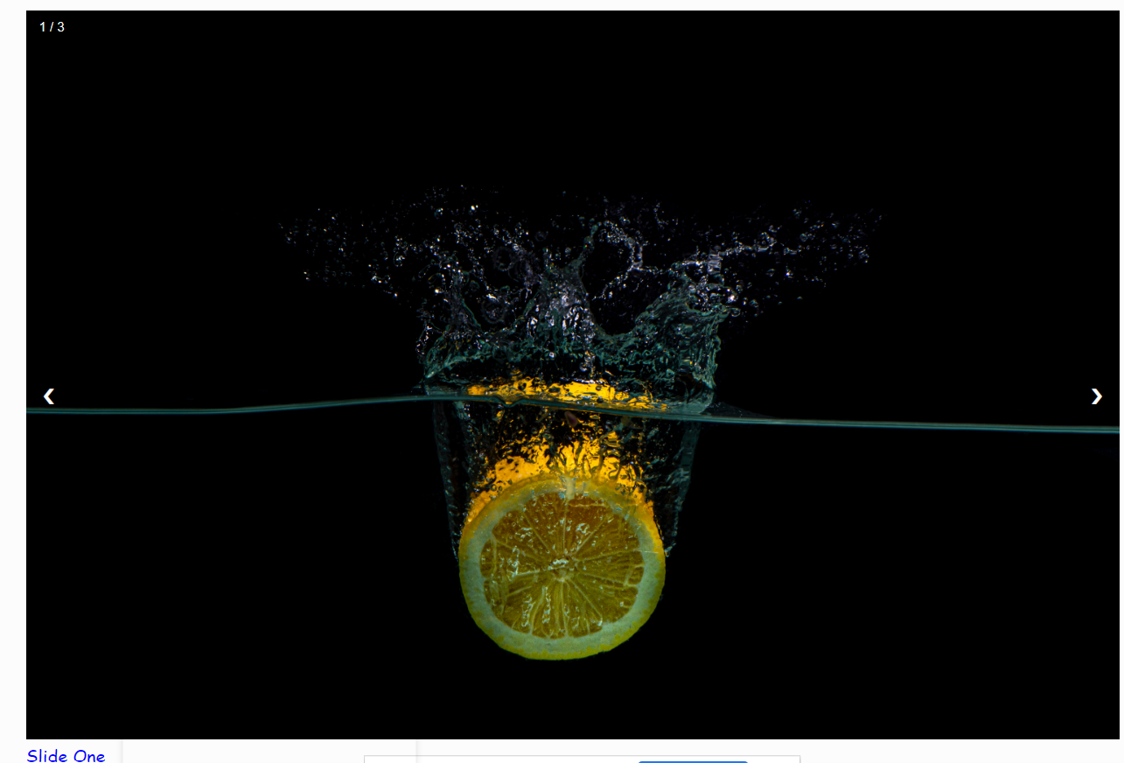
Project Feature 3: slide show

Slide 10
Description:
A slideshow is a presentation of a series of images. On my website, the changes are controlled by the user. I thought we need to include a slideshow because of the fabulous look on my website.

Slide 11
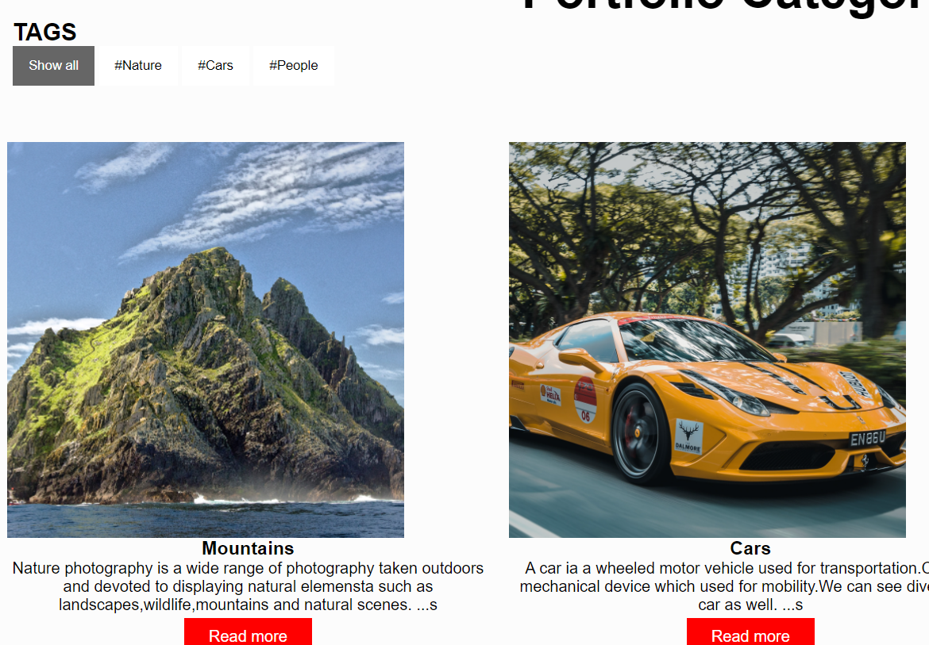
Project Feature 4: Tags

Slide 12
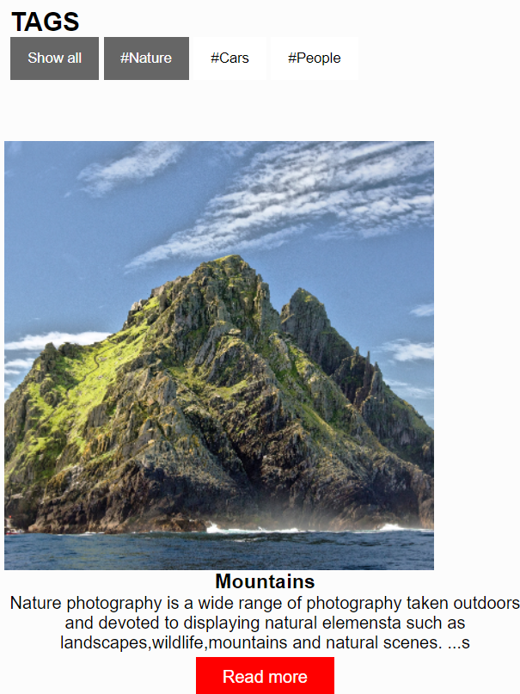

Slide 13
Description:
Tags feature would be a tough feature for me to create. I create different tags like nature, men, etc. If I am going to click on nature it will show the picture of men. Likewise, if I click the show all tag it will show all images that I have. This feature is for understanding to the clients how many diversity of pictures I can click.

Slide 14

Project Feature 5: Zoom-In

Slide 15
Description:
Basically, Zoom-in is to adjust the lens to show the picture bigger and closer. In short, It is used to magnify a picture and show in detail, a particular part of the picture zoomed.
I included that feature just because the clients can see the small details of my pictures and understand that I try to include every small measurement while clicking pictures.

Slide 16
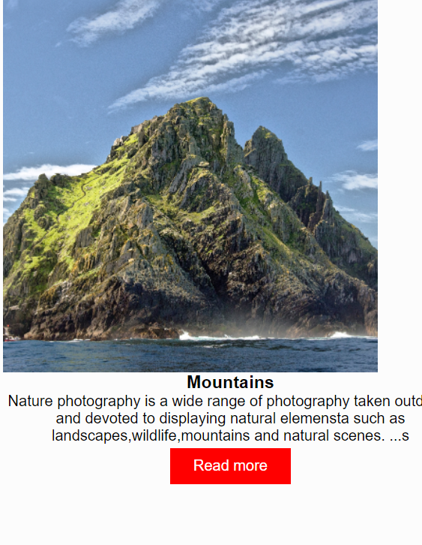
Project Feature 6: Read More

Slide 17
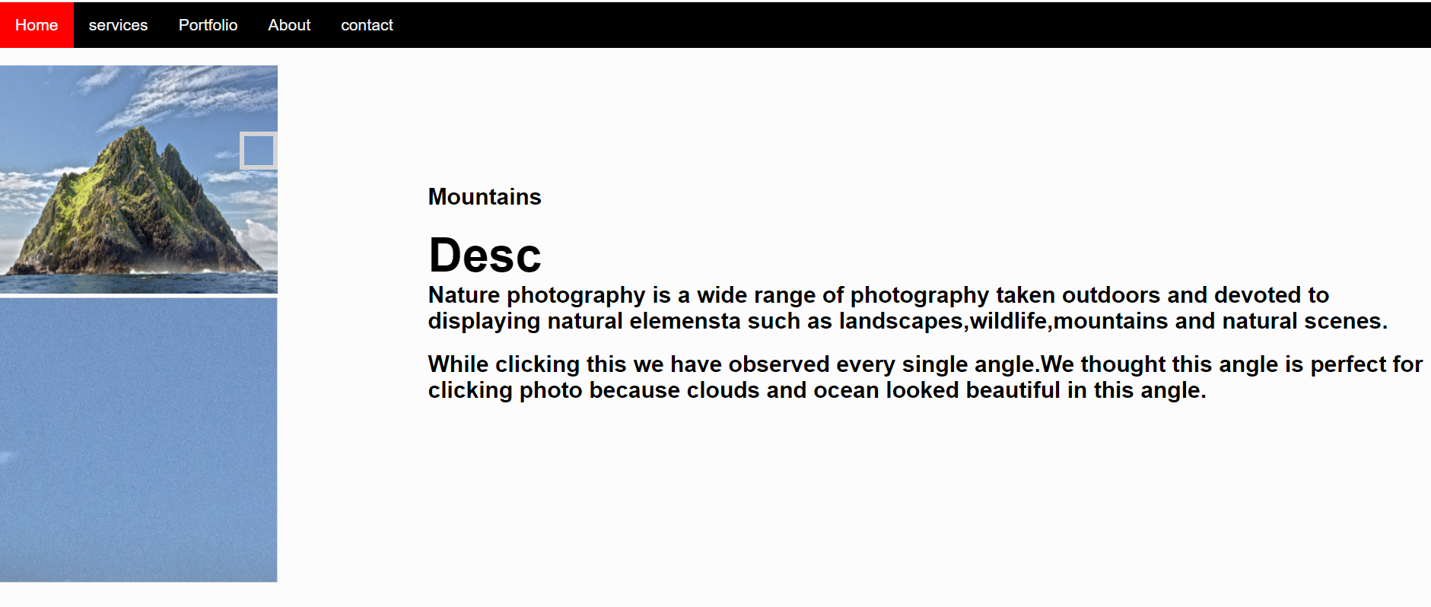

Slide 18
Description:
To read more, I wanted more pictures and fewer texts on the website, so I have added the read more to shorten the passages. If I click on the read more button, then it will give detailed information about that picture.

Slide 19
Thank You

